Slide 1
Smart Door Lock RestEasy
Hector Garcia Boissier
CSC8566

Slide 2
Overview
Domain of Application
The RestEasy Smart Door Lock address the Smart Building Domain
IoT Security device for locking and unlocking doors
Purpose
Combine locking mechanism with passcode security
Improve building security by controlling access to doors and buildings
Monitor door status and passcode inputs
Additional layer of security that could be integrated with other intrusion detection systems in the Smart Building Domain
Provide a security solution that could be marketed and distributed across multiple buildings

Slide 3
Overall Enterprise Architecture
IoT Sensor Net Architecture for final enterprise solution
Multiple Smart Door Locks
Central monitoring and control done in the could
Required entities
Door Lock:
ESP32 Wrover
Keypad – Reads user input
Servo motor – Activates locking mechanism
LED – Signals door status to user
Capacitive proximity sensor – Detects door frame
MQTT Broker – Enables MQTT Pub Sub communications
Node-red – Flow control to determine actuator and database response based on sensor data
MySQL – Central storage of data collected
Web Application – Allows security staff to observe data and generate reports

Slide 4
Final Project Implementation
Required Features
Validate and store every input of 4 pressed keys on the door lock keypad
Door lock activates only when user inputs the right passcode
Door lock response is visible to the user
Wrong passcode entries are stored for future investigation
Status of door lock components should be stored and updated
Updating the passcode for the door on the DB side should be effective in the next keypad activation

Slide 5
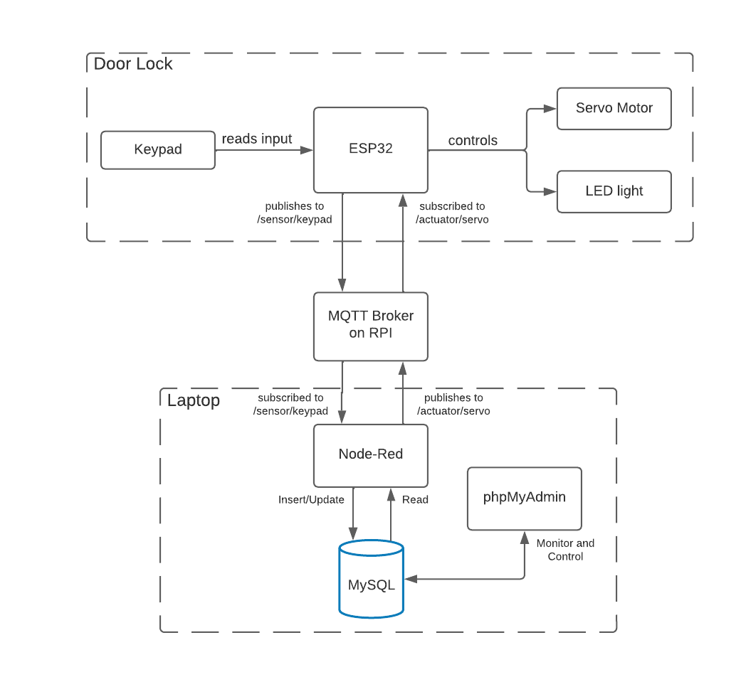
Final Project Implementation

Slide 6
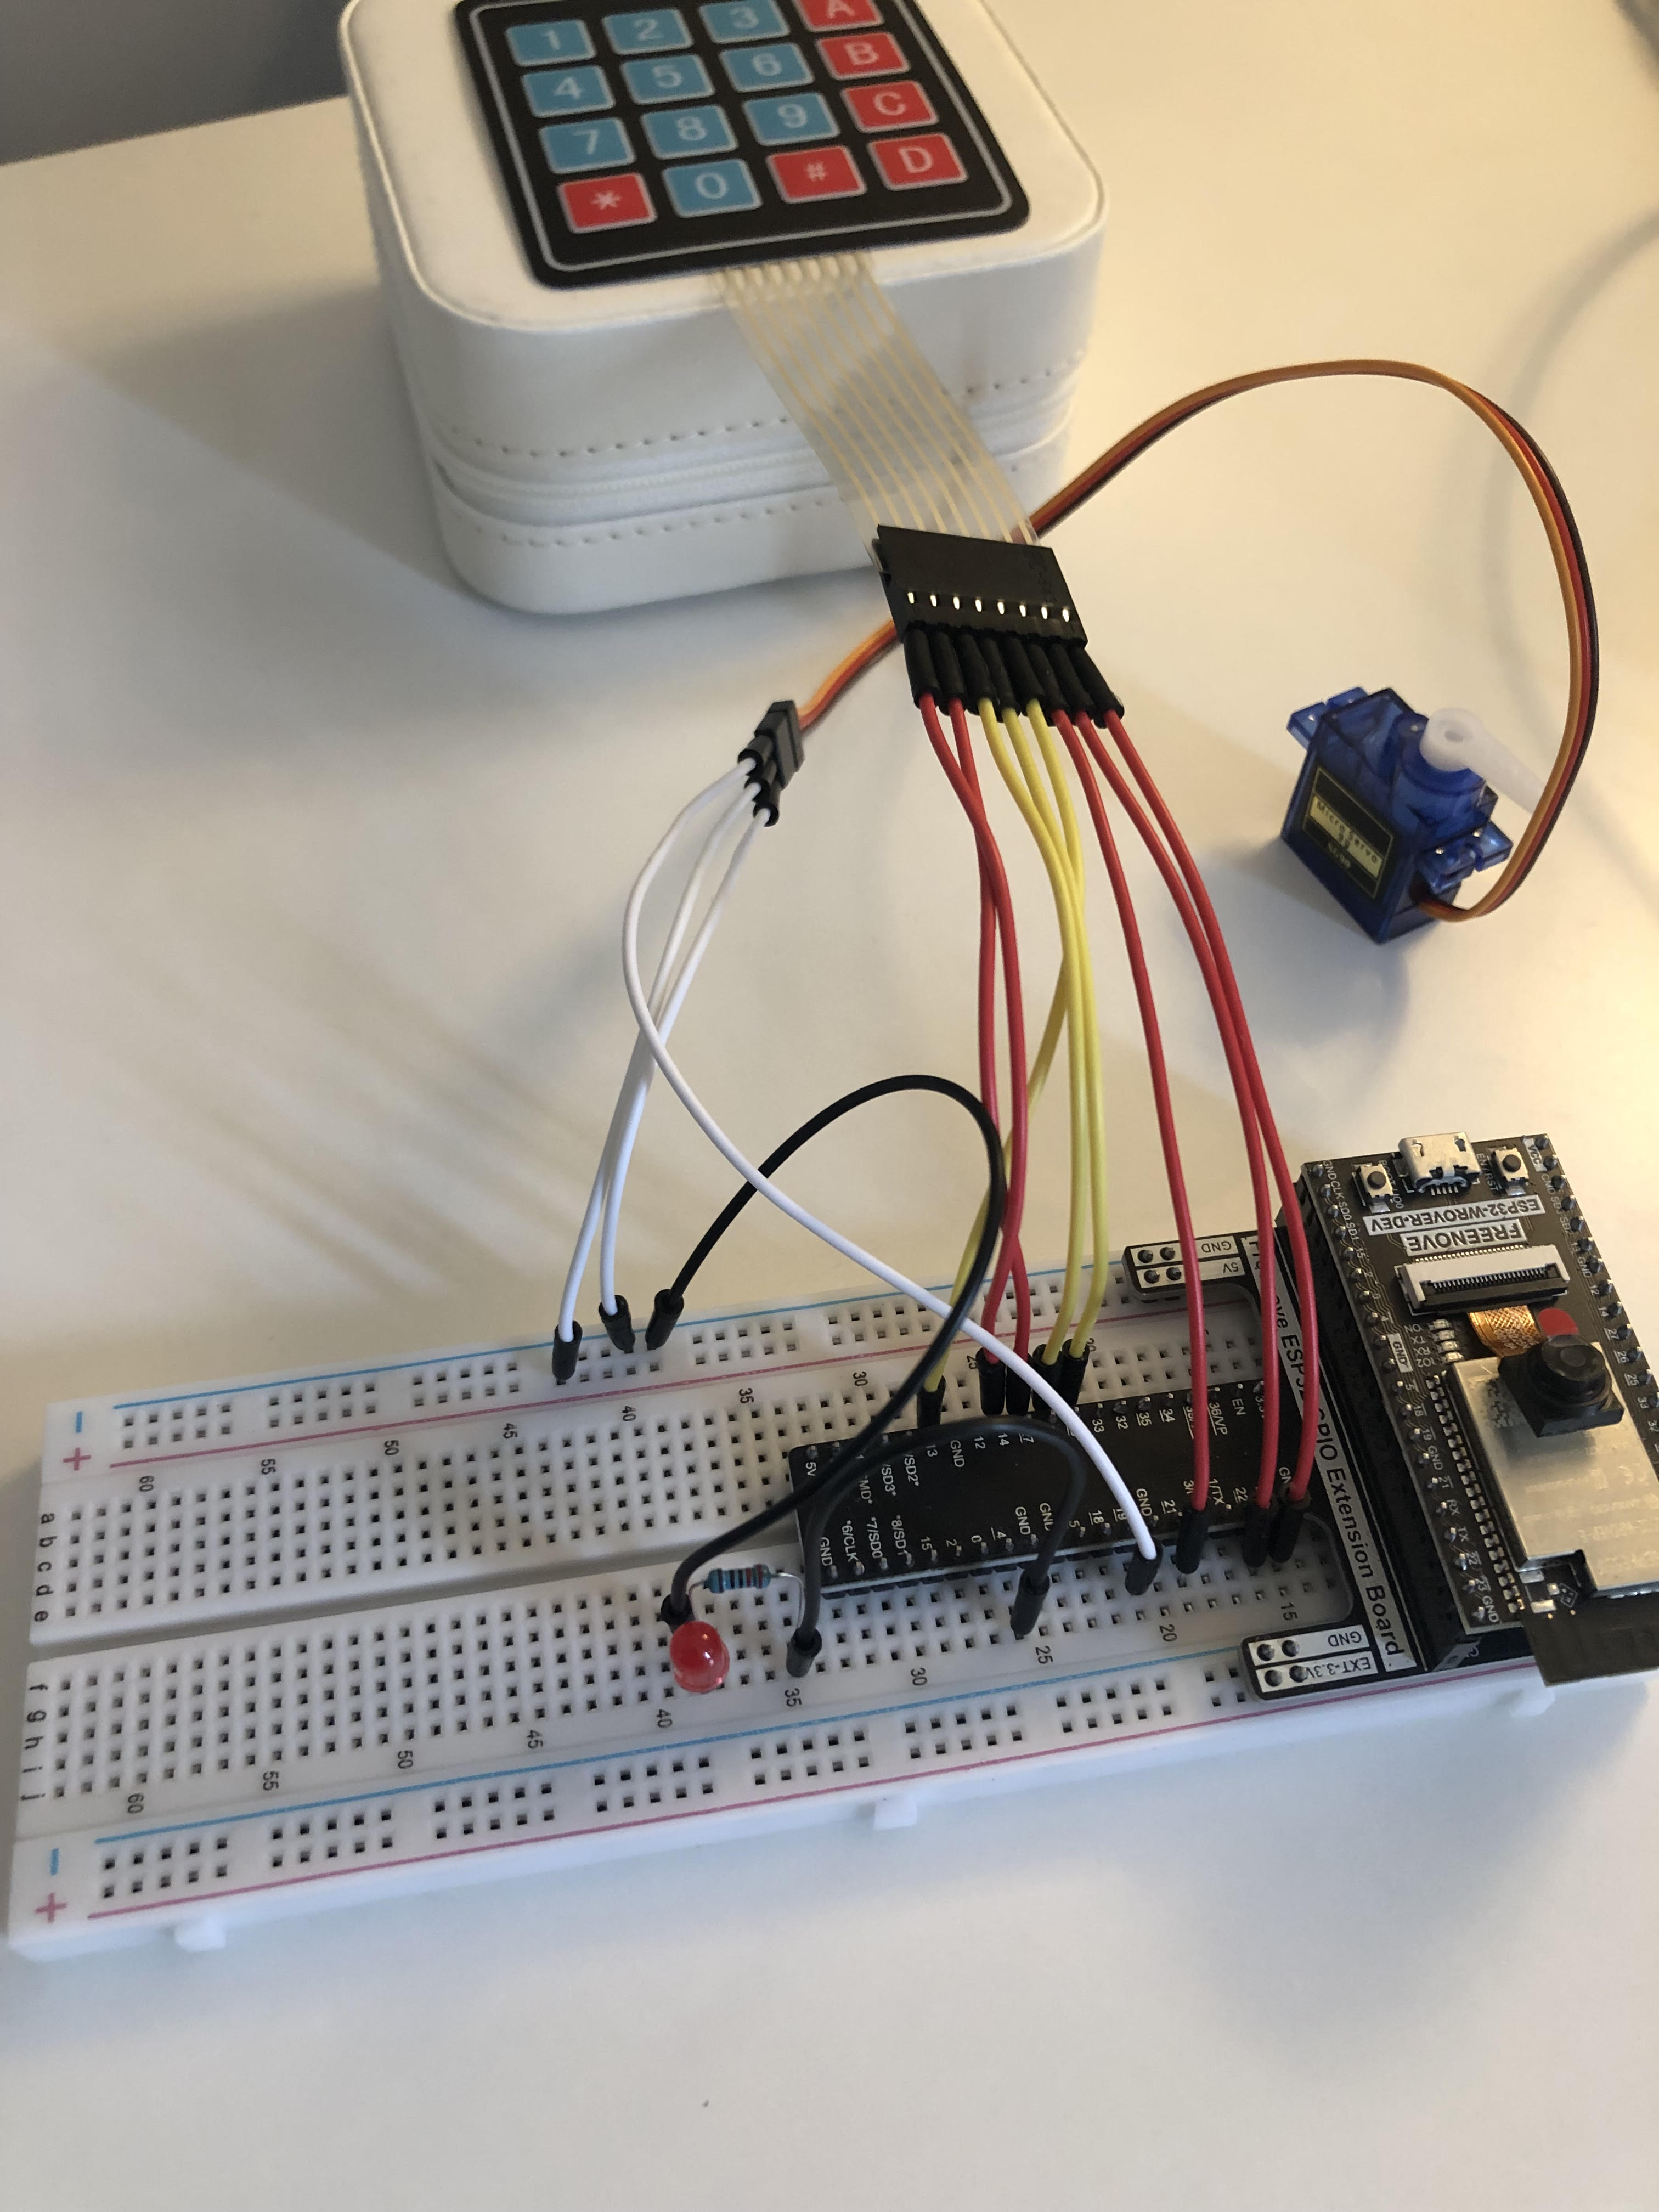
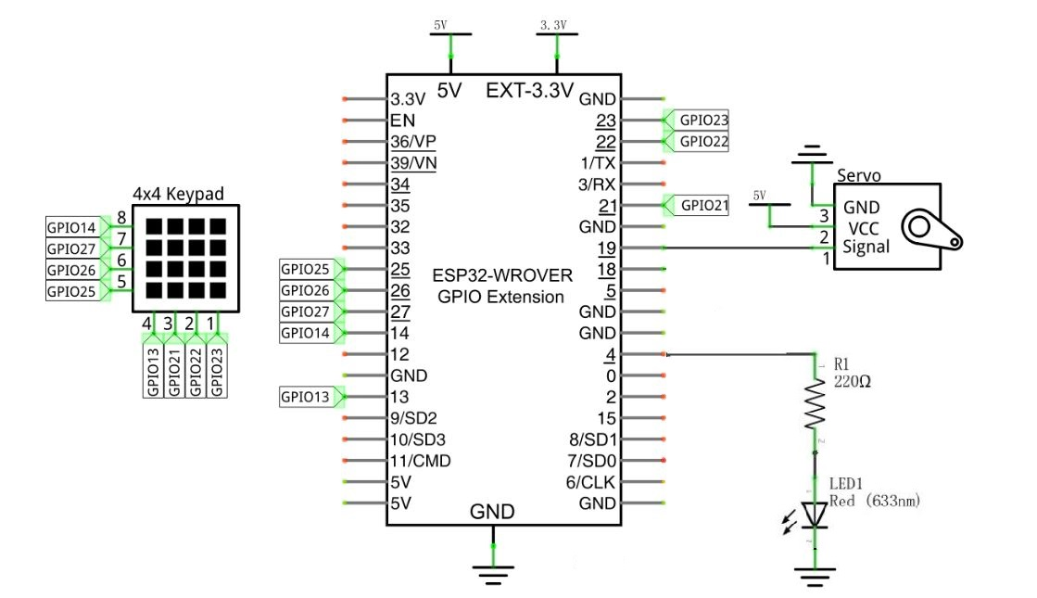
Hardware Setup
Schematic Diagram
Final Circuit

Slide 7
Process Specification for Demo
ESP32 connects to WiFi and MQTT Broker running on RPI
Keypad input is published to /sensor/keypad
Node-RED subscribed to /sensor/keypad retrieves current passcode for the door lock from MySQL and checks user input
User input is stored in keypad table
Node-RED publishes response message to /actuator/servo based on input:
If passcode is incorrect -> control message will trigger ESP32 to blink Red LED to notify user
If passcode is correct -> control message will trigger ESP32 to activate locking mechanism
When activating the lock, ESP32 will publish the updated state of servo to /actuator/servo/value
Node-RED will subscribe to /actuator/servo/value and update MySQL
Wrong passcodes trigger Node-RED flow to insert data entry into report_failed_attempts table

